Slide 1
Unit III – Database Design
Database Design with E-R Model: Overview of the Design Process, The Entity-Relational Model, Constraints, Removing Redundant Attributes in Entity set, Reduction to Relational Schema, Entity-Relationship Design issues, Extended E-R features, Alternative Notions for Modelling, Other accepts of Database Design.
Relational Database Design: Features of Good Relational Designs, Atomic Domains and First Normal Form, Decomposition using Functional Dependencies, Algorithms for Decomposition, Decomposition using multivalued Dependencies. More Normal forms, Database-Design Process, Modelling Temporal Data.

Slide 2
Chapter 7 Entity-Relationship Model

Slide 3
Chapter 7 Entity-Relationship Model
Design Process
Modeling
Constraints
E-R Diagram
Design Issues
Weak Entity Sets
Extended E-R Features
Design of the Bank Database
Reduction to Relation Schemas
Database Design
UML

Slide 4
Design Phases
The initial phase of database design is to characterize fully the data needs of the prospective database users.
Next, the designer chooses a data model and, by applying the concepts of the chosen data model, translates these requirements into a conceptual schema of the database.
A fully developed conceptual schema also indicates the functional requirements of the enterprise. In a “specification of functional requirements”, users describe the kinds of operations (or transactions) that will be performed on the data.
Notes:
4

Slide 5
Design Phases (Cont.)
The process of moving from an abstract data model to the implementation of the database proceeds in two final design phases.
Logical Design – Deciding on the database schema. Database design requires that we find a “good” collection of relation schemas.
Business decision – What attributes should we record in the database?
Computer Science decision – What relation schemas should we have and how should the attributes be distributed among the various relation schemas?
Physical Design – Deciding on the physical layout of the database
Notes:
5

Slide 6
Design Approaches
Entity Relationship Model (covered in this chapter)
Models an enterprise as a collection of entities and relationships
Entity: a “thing” or “object” in the enterprise that is distinguishable from other objects
Described by a set of attributes
Relationship: an association among several entities
Represented diagrammatically by an entity-relationship diagram:
Normalization Theory (Chapter 8)
Formalize what designs are bad, and test for them
Notes:
6

Slide 7
Outline of the ER Model

Slide 8
ER model -- Database Modeling
The ER data mode was developed to facilitate database design by allowing specification of an enterprise schema that represents the overall logical structure of a database.
The ER model is very useful in mapping the meanings and interactions of real-world enterprises onto a conceptual schema. Because of this usefulness, many database-design tools draw on concepts from the ER model.
The ER data model employs three basic concepts:
entity sets,
relationship sets,
attributes.
The ER model also has an associated diagrammatic representation, the ER diagram, which can express the overall logical structure of a database graphically.

Slide 9
Entity Sets
An entity is an object that exists and is distinguishable from other objects.
Example: specific person, company, event, plant
An entity set is a set of entities of the same type that share the same properties.
Example: set of all persons, companies, trees, holidays
An entity is represented by a set of attributes; i.e., descriptive properties possessed by all members of an entity set.
Example:
instructor = (ID, name, street, city, salary ) course= (course_id, title, credits)
A subset of the attributes form a primary key of the entity set; i.e., uniquely identifiying each member of the set.

Slide 10
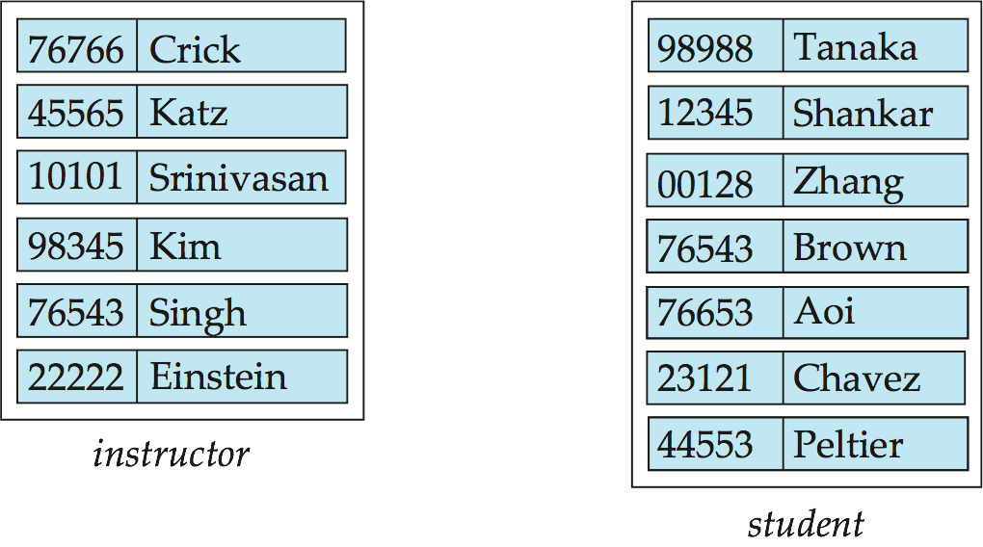
Entity Sets -- instructor and student
instructor_ID instructor_name student-ID student_name

Slide 11
Relationship Sets
A relationship is an association among several entities
Example: 44553 (Peltier) advisor 22222 (Einstein) student entity relationship set instructor entity
A relationship set is a mathematical relation among n ≥ 2 entities, each taken from entity sets
{(e₁, e₂, … e_{n}) | e₁ ∈ E₁, e₂ ∈ E₂, …, e_{n} ∈ E_{n}} where (e₁, e₂, …, e_{n}) is a relationship
Example:
(44553,22222) ∈ advisor

Slide 12
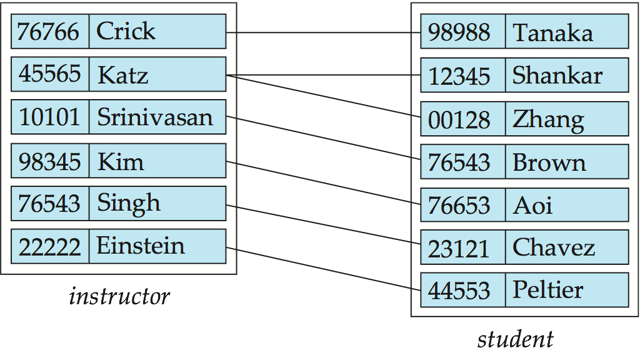
Relationship Set advisor

Slide 13
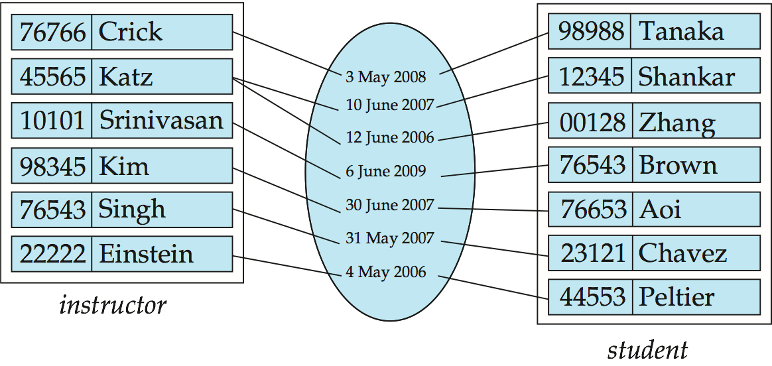
Relationship Sets (Cont.)
An attribute can also be associated with a relationship set.
For instance, the advisor relationship set between entity sets instructor and student may have the attribute date which tracks when the student started being associated with the advisor

Slide 14
Degree of a Relationship Set
binary relationship
involve two entity sets (or degree two).
most relationship sets in a database system are binary.
Relationships between more than two entity sets are rare. Most relationships are binary. (More on this later.)
Example: students work on research projects under the guidance of an instructor.
relationship proj_guide is a ternary relationship between instructor, student, and project

Slide 15
Mapping Cardinality Constraints
Express the number of entities to which another entity can be associated via a relationship set.
Most useful in describing binary relationship sets.
For a binary relationship set the mapping cardinality must be one of the following types:
One to one
One to many
Many to one
Many to many

Slide 16
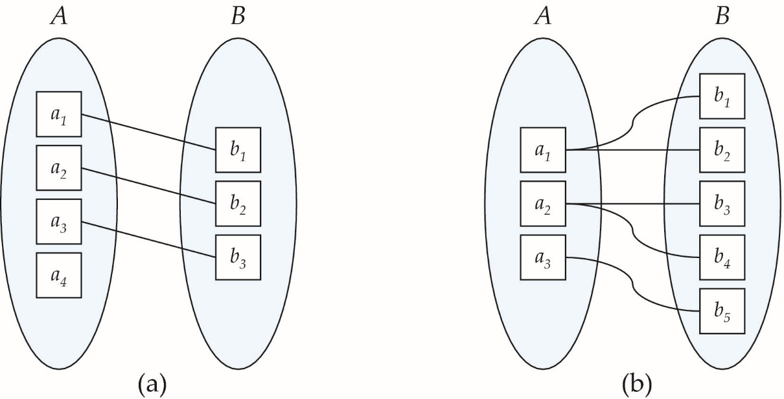
Mapping Cardinalities
One to one
One to many
Note: Some elements in A and B may not be mapped to any elements in the other set

Slide 17
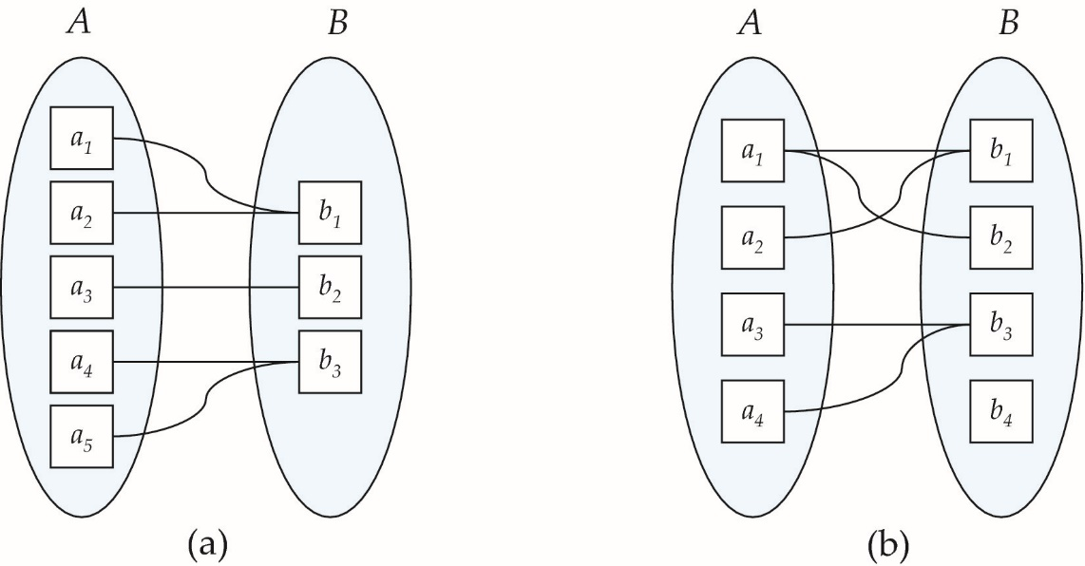
Mapping Cardinalities
Many to one
Many to many
Note: Some elements in A and B may not be mapped to any elements in the other set

Slide 18
Complex Attributes
Attribute types:
Simple and composite attributes.
Single-valued and multivalued attributes
Example: multivalued attribute: phone_numbers
Derived attributes
Can be computed from other attributes
Example: age, given date_of_birth
Domain – the set of permitted values for each attribute

Slide 19
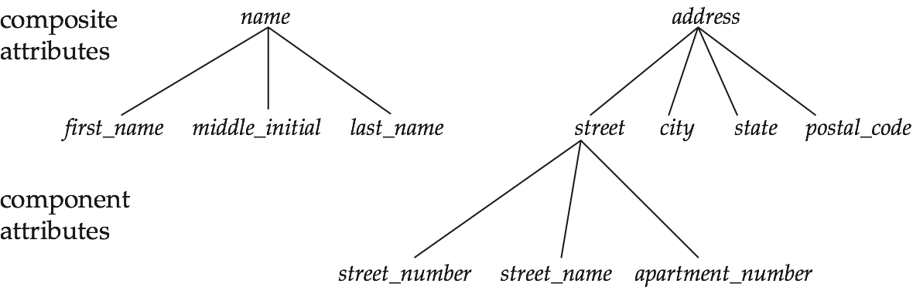
Composite Attributes

Slide 20
Redundant Attributes
Suppose we have entity sets:
instructor, with attributes: ID, name, dept_name, salary
department, with attributes: dept_name, building, budget
We model the fact that each instructor has an associated department using a relationship set inst_dept
The attribute dept_name appears in both entity sets. Since it is the primary key for the entity set department, it replicates information present in the relationship and is therefore redundant in the entity set instructor and needs to be removed.
BUT: when converting back to tables, in some cases the attribute gets reintroduced, as we will see later.

Slide 21
Weak Entity Sets
Consider a section entity, which is uniquely identified by a course_id, semester, year, and sec_id.
Clearly, section entities are related to course entities. Suppose we create a relationship set sec_course between entity sets section and course.
Note that the information in sec_course is redundant, since section already has an attribute course_id, which identifies the course with which the section is related.
One option to deal with this redundancy is to get rid of the relationship sec_course; however, by doing so the relationship between section and course becomes implicit in an attribute, which is not desirable.

Slide 22
Weak Entity Sets (Cont.)
An alternative way to deal with this redundancy is to not store the attribute course_id in the section entity and to only store the remaining attributes section_id, year, and semester. However, the entity set section then does not have enough attributes to identify a particular section entity uniquely; although each section entity is distinct, sections for different courses may share the same section_id, year, and semester.
To deal with this problem, we treat the relationship sec_course as a special relationship that provides extra information, in this case, the course_id, required to identify section entities uniquely.
The notion of weak entity set formalizes the above intuition. A weak entity set is one whose existence is dependent on another entity, called its identifying entity; instead of associating a primary key with a weak entity, we use the identifying entity, along with extra attributes called discriminator to uniquely identify a weak entity. An entity set that is not a weak entity set is termed a strong entity set.

Slide 23
Weak Entity Sets (Cont.)
Every weak entity must be associated with an identifying entity; that is, the weak entity set is said to be existence dependent on the identifying entity set. The identifying entity set is said to own the weak entity set that it identifies. The relationship associating the weak entity set with the identifying entity set is called the identifying relationship.
Note that the relational schema we eventually create from the entity set section does have the attribute course_id, for reasons that will become clear later, even though we have dropped the attribute course_id from the entity set section.

Slide 24
E-R Diagrams

Slide 25
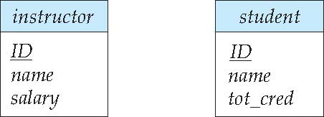
Entity Sets
Entities can be represented graphically as follows:
Rectangles represent entity sets.
Attributes listed inside entity rectangle
Underline indicates primary key attributes

Slide 26
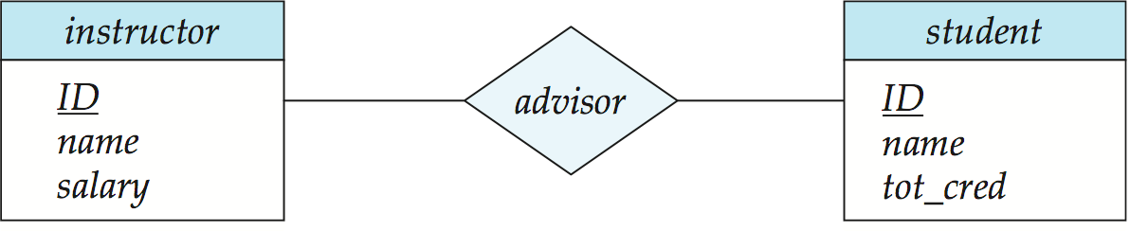
Relationship Sets
Diamonds represent relationship sets.

Slide 27
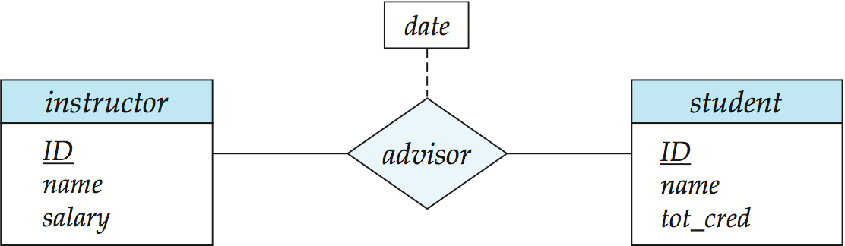
Relationship Sets with Attributes

Slide 28
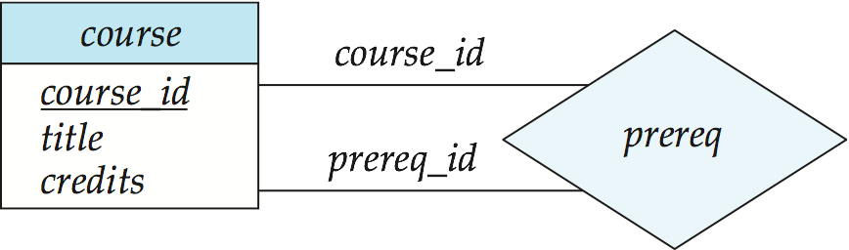
Roles
Entity sets of a relationship need not be distinct
Each occurrence of an entity set plays a “role” in the relationship
The labels “course_id” and “prereq_id” are called roles.

Slide 29
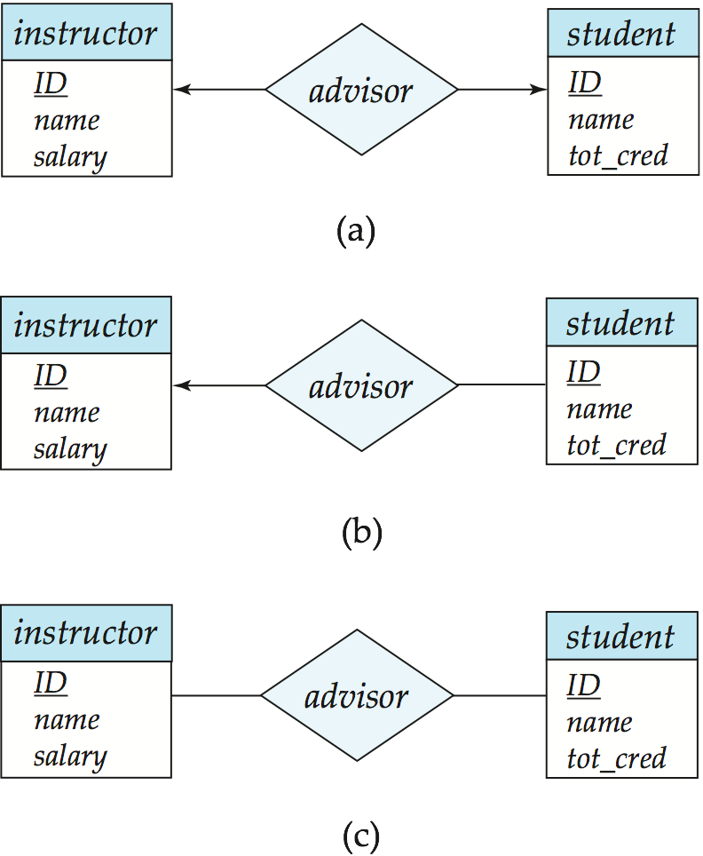
Cardinality Constraints
We express cardinality constraints by drawing either a directed line (→), signifying “one,” or an undirected line (—), signifying “many,” between the relationship set and the entity set.
One-to-one relationship between an instructor and a student :
A student is associated with at most one instructor via the relationship advisor
A student is associated with at most one department via stud_dept

Slide 30
One-to-Many Relationship
one-to-many relationship between an instructor and a student
an instructor is associated with several (including 0) students via advisor
a student is associated with at most one instructor via advisor,

Slide 31
Many-to-One Relationships
In a many-to-one relationship between an instructor and a student,
an instructor is associated with at most one student via advisor,
and a student is associated with several (including 0) instructors via advisor

Slide 32
Many-to-Many Relationship
An instructor is associated with several (possibly 0) students via advisor
A student is associated with several (possibly 0) instructors via advisor

Slide 33
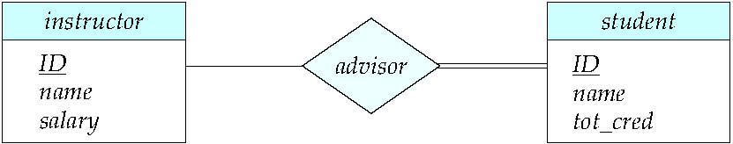
Total and Partial Participation
Total participation (indicated by double line): every entity in the entity set participates in at least one relationship in the relationship set
participation of student in advisor relation is total
every student must have an associated instructor
Partial participation: some entities may not participate in any relationship in the relationship set
Example: participation of instructor in advisor is partial

Slide 34
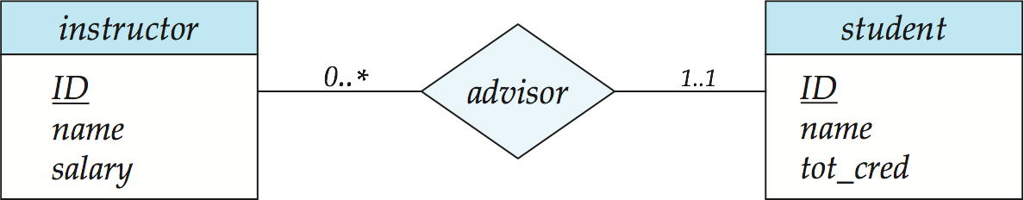
Notation for Expressing More Complex Constraints
A line may have an associated minimum and maximum cardinality, shown in the form l..h, where l is the minimum and h the maximum cardinality
A minimum value of 1 indicates total participation.
A maximum value of 1 indicates that the entity participates in at most one relationship
A maximum value of * indicates no limit.
Note: Instructor can advise 0 or more students. A student must have advisor; cannot have multiple advisors

Slide 35
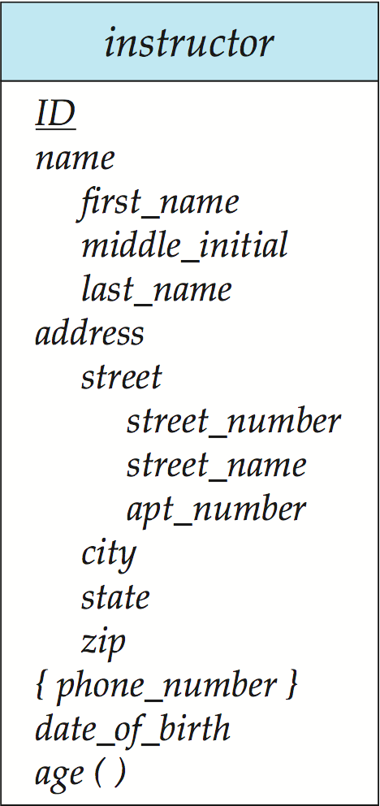
Notation to Express Entity with Complex Attributes

Slide 36
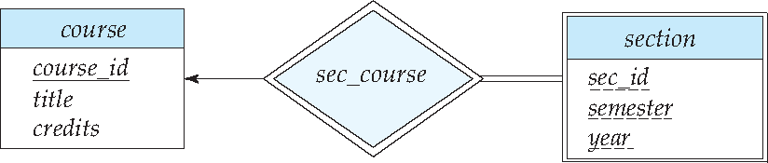
Expressing Weak Entity Sets
In E-R diagrams, a weak entity set is depicted via a double rectangle.
We underline the discriminator of a weak entity set with a dashed line.
The relationship set connecting the weak entity set to the identifying strong entity set is depicted by a double diamond.
Primary key for section – (course_id, sec_id, semester, year)

Slide 37
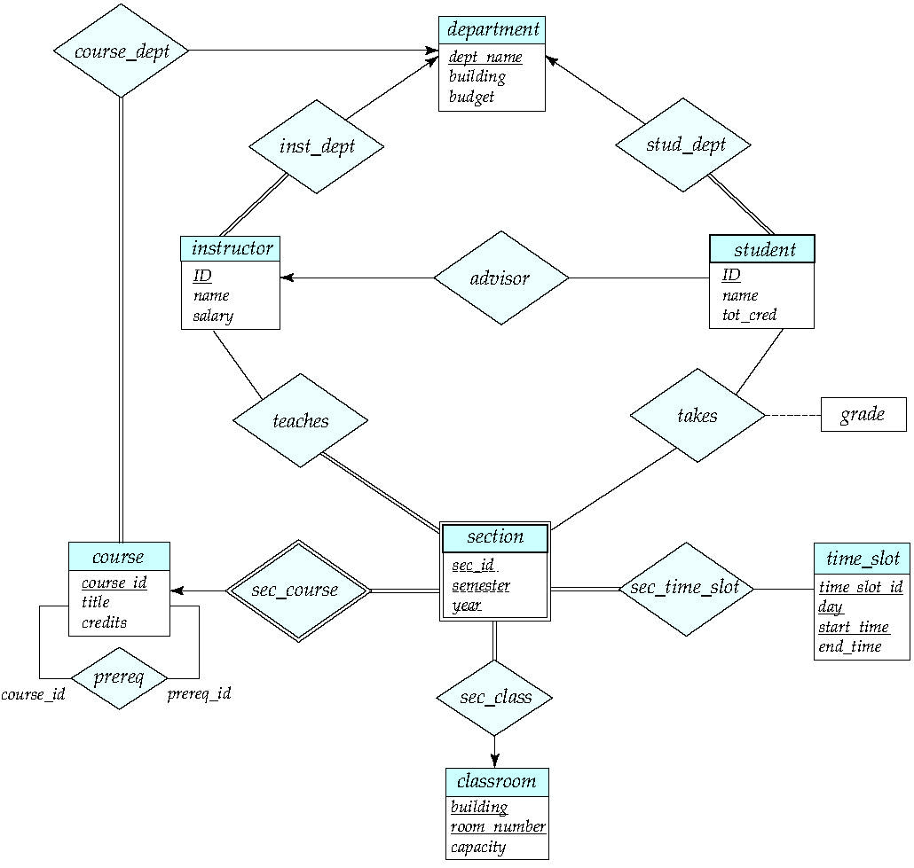
E-R Diagram for a University Enterprise

Slide 38
Reduction to Relation Schemas

Slide 39
Reduction to Relation Schemas
Entity sets and relationship sets can be expressed uniformly as relation schemas that represent the contents of the database.
A database which conforms to an E-R diagram can be represented by a collection of schemas.
For each entity set and relationship set there is a unique schema that is assigned the name of the corresponding entity set or relationship set.
Each schema has a number of columns (generally corresponding to attributes), which have unique names.

Slide 40
Representing Entity Sets
A strong entity set reduces to a schema with the same attributes
student(ID, name, tot_cred)
A weak entity set becomes a table that includes a column for the primary key of the identifying strong entity set
section ( course_id, sec_id, sem, year )

Slide 41
Representing Relationship Sets
A many-to-many relationship set is represented as a schema with attributes for the primary keys of the two participating entity sets, and any descriptive attributes of the relationship set.
Example: schema for relationship set advisor
advisor = (s_id, i_id)

Slide 42
Representation of Entity Sets with Composite Attributes
Composite attributes are flattened out by creating a separate attribute for each component attribute
Example: given entity set instructor with composite attribute name with component attributes first_name and last_name the schema corresponding to the entity set has two attributes name_first_name and name_last_name
Prefix omitted if there is no ambiguity (name_first_name could be first_name)
Ignoring multivalued attributes, extended instructor schema is
instructor(ID, first_name, middle_initial, last_name, street_number, street_name, apt_number, city, state, zip_code, date_of_birth)
Notes:
42

Slide 43
Representation of Entity Sets with Multivalued Attributes
A multivalued attribute M of an entity E is represented by a separate schema EM
Schema EM has attributes corresponding to the primary key of E and an attribute corresponding to multivalued attribute M
Example: Multivalued attribute phone_number of instructor is represented by a schema: inst_phone= ( ID, phone_number)
Each value of the multivalued attribute maps to a separate tuple of the relation on schema EM
For example, an instructor entity with primary key 22222 and phone numbers 456-7890 and 123-4567 maps to two tuples: (22222, 456-7890) and (22222, 123-4567)
Notes:
43

Slide 44
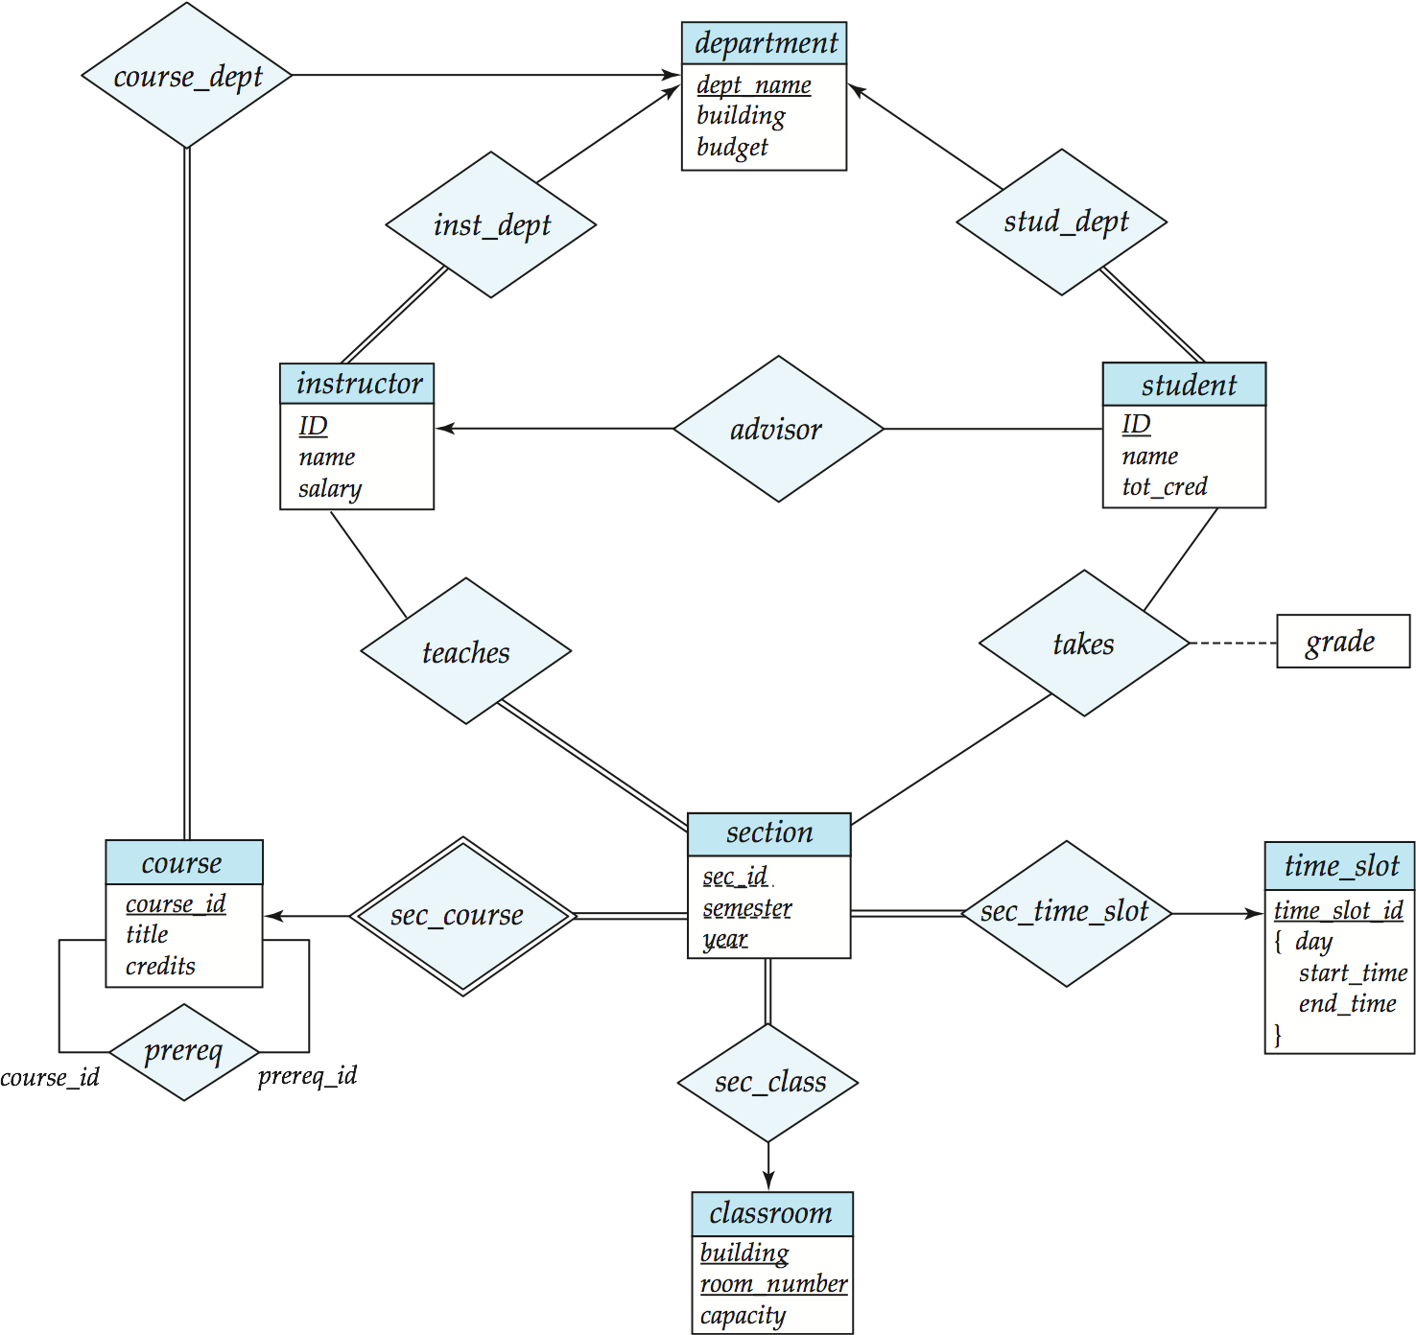
Redundancy of Schemas
Many-to-one and one-to-many relationship sets that are total on the many-side can be represented by adding an extra attribute to the “many” side, containing the primary key of the “one” side
Example: Instead of creating a schema for relationship set inst_dept, add an attribute dept_name to the schema arising from entity set instructor

Slide 45
Redundancy of Schemas (Cont.)
For one-to-one relationship sets, either side can be chosen to act as the “many” side
That is, an extra attribute can be added to either of the tables corresponding to the two entity sets
If participation is partial on the “many” side, replacing a schema by an extra attribute in the schema corresponding to the “many” side could result in null values
Notes:
45

Slide 46
Redundancy of Schemas (Cont.)
The schema corresponding to a relationship set linking a weak entity set to its identifying strong entity set is redundant.
Example: The section schema already contains the attributes that would appear in the sec_course schema
Notes:
46

Slide 47
Advanced Topics

Slide 48
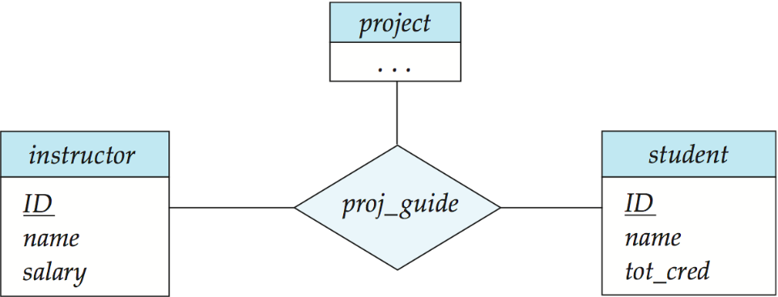
Non-binary Relationship Sets
Most relationship sets are binary
There are occasions when it is more convenient to represent relationships as non-binary.
E-R Diagram with a Ternary Relationship

Slide 49
Cardinality Constraints on Ternary Relationship
We allow at most one arrow out of a ternary (or greater degree) relationship to indicate a cardinality constraint
For exampe, an arrow from proj_guide to instructor indicates each student has at most one guide for a project
If there is more than one arrow, there are two ways of defining the meaning.
For example, a ternary relationship R between A, B and C with arrows to B and C could mean
1.Each A entity is associated with a unique entity from B and C or
2. Each pair of entities from (A, B) is associated with a unique C entity, and each pair (A, C) is associated with a unique B
Each alternative has been used in different formalisms
To avoid confusion we outlaw more than one arrow

Slide 50
Specialization
Top-down design process; we designate sub-groupings within an entity set that are distinctive from other entities in the set.
These sub-groupings become lower-level entity sets that have attributes or participate in relationships that do not apply to the higher-level entity set.
Depicted by a triangle component labeled ISA (e.g., instructor “is a” person).
Attribute inheritance – a lower-level entity set inherits all the attributes and relationship participation of the higher-level entity set to which it is linked.

Slide 51
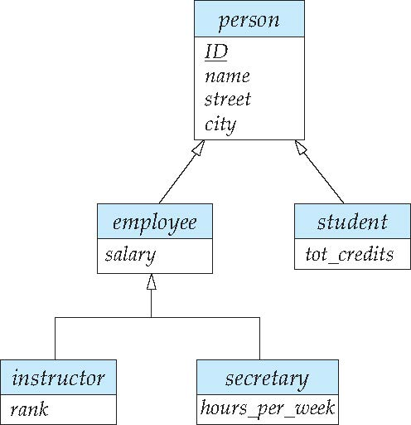
Specialization Example
Overlapping – employee and student
Disjoint – instructor and secretary
Total and partial

Slide 52
Representing Specialization via Schemas
Method 1:
Form a schema for the higher-level entity
Form a schema for each lower-level entity set, include primary key of higher-level entity set and local attributes
Drawback: getting information about, an employee requires accessing two relations, the one corresponding to the low-level schema and the one corresponding to the high-level schema
schema attributes
person ID, name, street, city
student ID, tot_cred
employee ID, salary
Notes:
52

Slide 53
Representing Specialization as Schemas (Cont.)
Method 2:
Form a schema for each entity set with all local and inherited attributes
Drawback: name, street and city may be stored redundantly for people who are both students and employees
schema attributes
person ID, name, street, city
student ID, name, street, city, tot_cred
employee ID, name, street, city, salary
Notes:
53

Slide 54
Generalization
A bottom-up design process – combine a number of entity sets that share the same features into a higher-level entity set.
Specialization and generalization are simple inversions of each other; they are represented in an E-R diagram in the same way.
The terms specialization and generalization are used interchangeably.

Slide 55
Design Constraints on a Specialization/Generalization
Completeness constraint -- specifies whether or not an entity in the higher-level entity set must belong to at least one of the lower-level entity sets within a generalization.
total: an entity must belong to one of the lower-level entity sets
partial: an entity need not belong to one of the lower-level entity sets
Partial generalization is the default. We can specify total generalization in an ER diagram by adding the keyword total in the diagram and drawing a dashed line from the keyword to the corresponding hollow arrow-head to which it applies (for a total generalization), or to the set of hollow arrow-heads to which it applies (for an overlapping generalization).
The student generalization is total: All student entities must be either graduate or undergraduate. Because the higher-level entity set arrived at through generalization is generally composed of only those entities in the lower-level entity sets, the completeness constraint for a generalized higher-level entity set is usually total

Slide 56
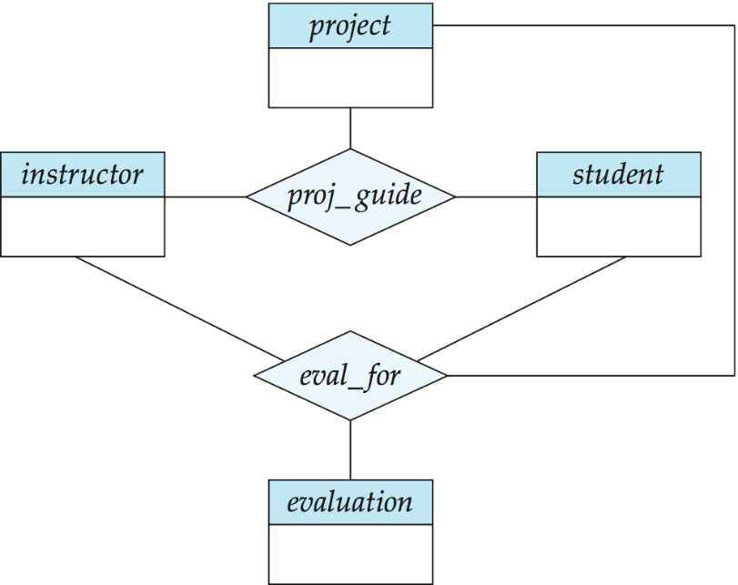
Aggregation
Consider the ternary relationship proj_guide, which we saw earlier
Suppose we want to record evaluations of a student by a guide on a project

Slide 57
Aggregation (Cont.)
Relationship sets eval_for and proj_guide represent overlapping information
Every eval_for relationship corresponds to a proj_guide relationship
However, some proj_guide relationships may not correspond to any eval_for relationships
So we can’t discard the proj_guide relationship
Eliminate this redundancy via aggregation
Treat relationship as an abstract entity
Allows relationships between relationships
Abstraction of relationship into new entity

Slide 58
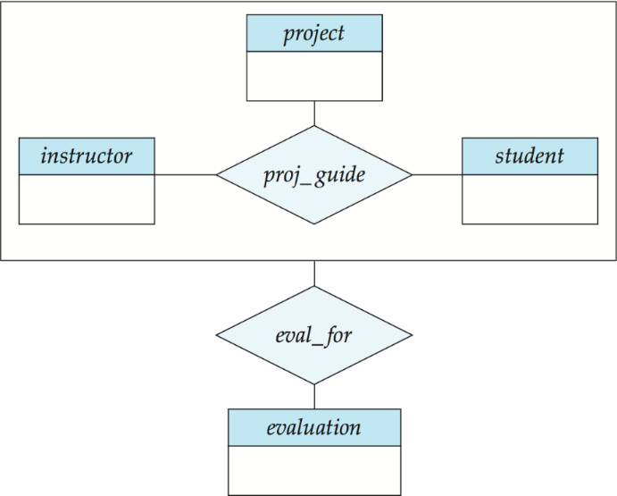
Aggregation (Cont.)
Eliminate this redundancy via aggregation without introducing redundancy, the following diagram represents:
A student is guided by a particular instructor on a particular project
A student, instructor, project combination may have an associated evaluation
Notes:
58

Slide 59
Representing Aggregation via Schemas
To represent aggregation, create a schema containing
Primary key of the aggregated relationship,
The primary key of the associated entity set
Any descriptive attributes
In our example:
The schema eval_for is:
eval_for (s_ID, project_id, i_ID, evaluation_id)
The schema proj_guide is redundant.

Slide 60
Design Issues

Slide 61
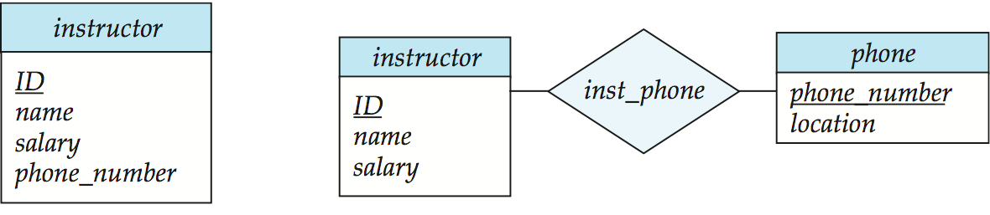
Entities vs. Attributes
Use of entity sets vs. attributes
Use of phone as an entity allows extra information about phone numbers (plus multiple phone numbers)
Notes:
61

Slide 62
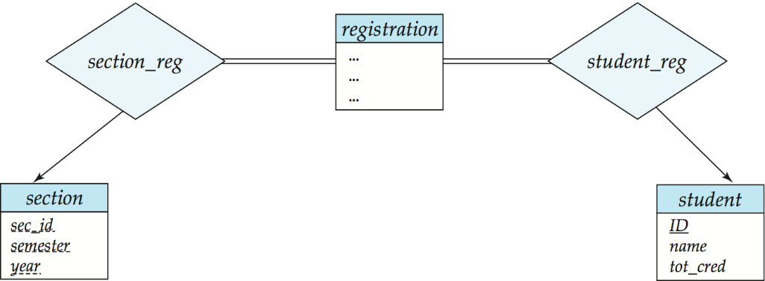
Entities vs. Relationship sets
Use of entity sets vs. relationship sets
Possible guideline is to designate a relationship set to describe an action that occurs between entities
Placement of relationship attributes
For example, attribute date as attribute of advisor or as attribute of student
Notes:
62

Slide 63
Binary Vs. Non-Binary Relationships
Although it is possible to replace any non-binary (n-ary, for n > 2) relationship set by a number of distinct binary relationship sets, a n-ary relationship set shows more clearly that several entities participate in a single relationship.
Some relationships that appear to be non-binary may be better represented using binary relationships
For example, a ternary relationship parents, relating a child to his/her father and mother, is best replaced by two binary relationships, father and mother
Using two binary relationships allows partial information (e.g., only mother being known)
But there are some relationships that are naturally non-binary
Example: proj_guide
Notes:
63

Slide 64
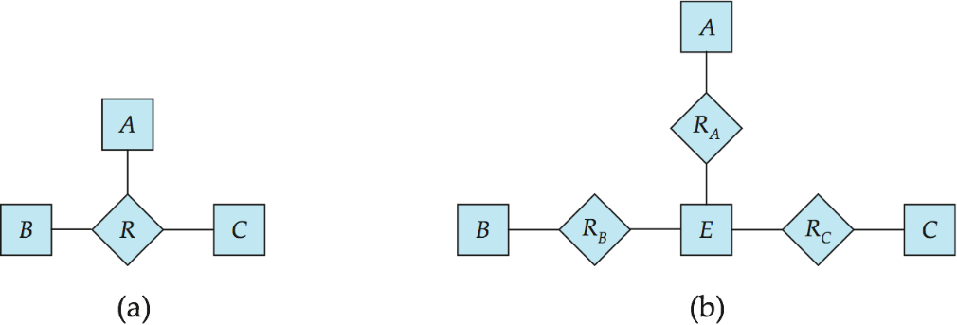
Converting Non-Binary Relationships to Binary Form
In general, any non-binary relationship can be represented using binary relationships by creating an artificial entity set.
Replace R between entity sets A, B and C by an entity set E, and three relationship sets:
1. R_{A}, relating E and A 2. R_{B}, relating E and B 3. R_{C}, relating E and C
Create an identifying attribute for E and add any attributes of R to E
For each relationship (a_{i} , b_{i} , c_{i}) in R, create
1. a new entity e_{i} in the entity set E 2. add (e_{i} , a_{i} ) to R_{A}
3. add (e_{i} , b_{i} ) to R_{B} 4. add (e_{i} , c_{i} ) to R_{C}
Notes:
64

Slide 65
Converting Non-Binary Relationships (Cont.)
Also need to translate constraints
Translating all constraints may not be possible
There may be instances in the translated schema that cannot correspond to any instance of R
Exercise: add constraints to the relationships R_{A}, R_{B} and R_{C} to ensure that a newly created entity corresponds to exactly one entity in each of entity sets A, B and C
We can avoid creating an identifying attribute by making E a weak entity set (described shortly) identified by the three relationship sets
Notes:
65

Slide 66
E-R Design Decisions
The use of an attribute or entity set to represent an object.
Whether a real-world concept is best expressed by an entity set or a relationship set.
The use of a ternary relationship versus a pair of binary relationships.
The use of a strong or weak entity set.
The use of specialization/generalization – contributes to modularity in the design.
The use of aggregation – can treat the aggregate entity set as a single unit without concern for the details of its internal structure.

Slide 67
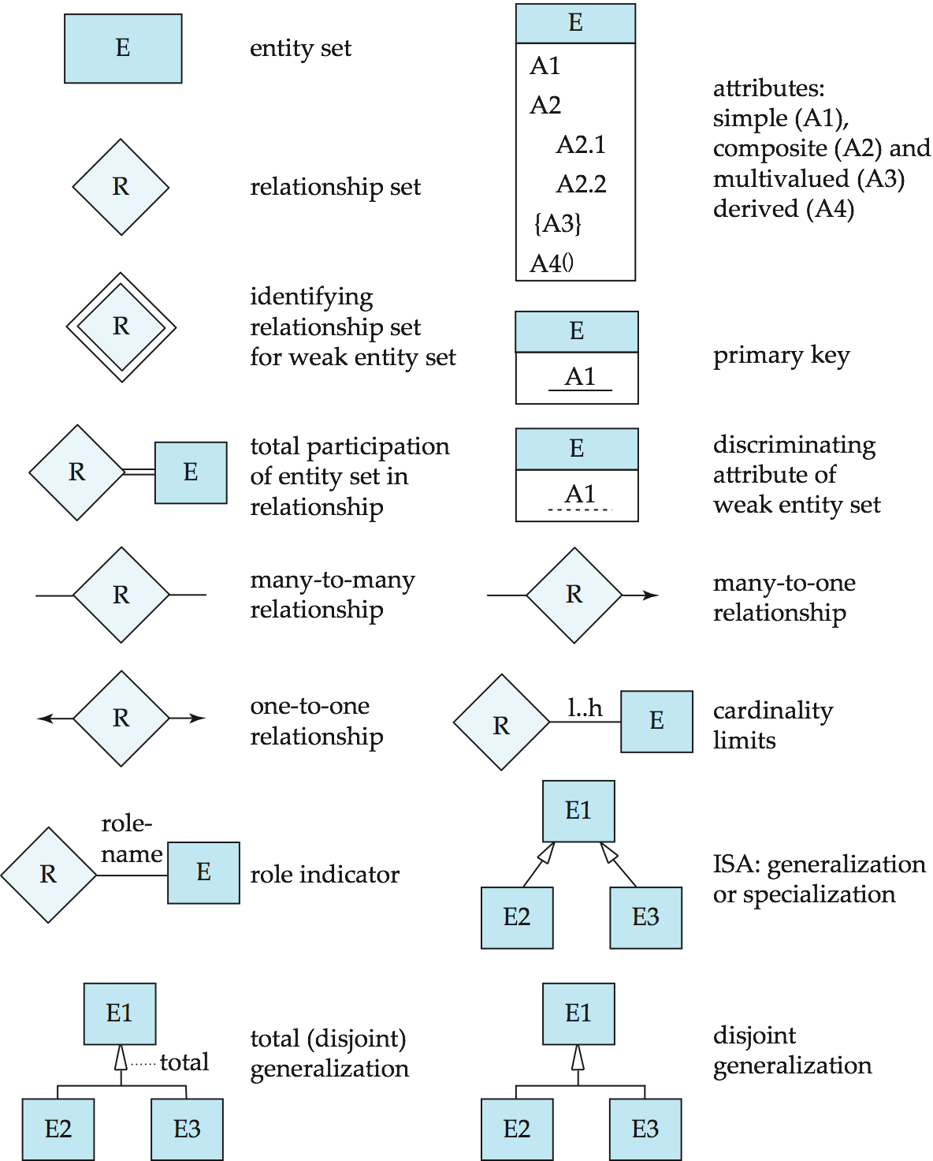
Summary of Symbols Used in E-R Notation

Slide 68
Symbols Used in E-R Notation (Cont.)

Slide 69
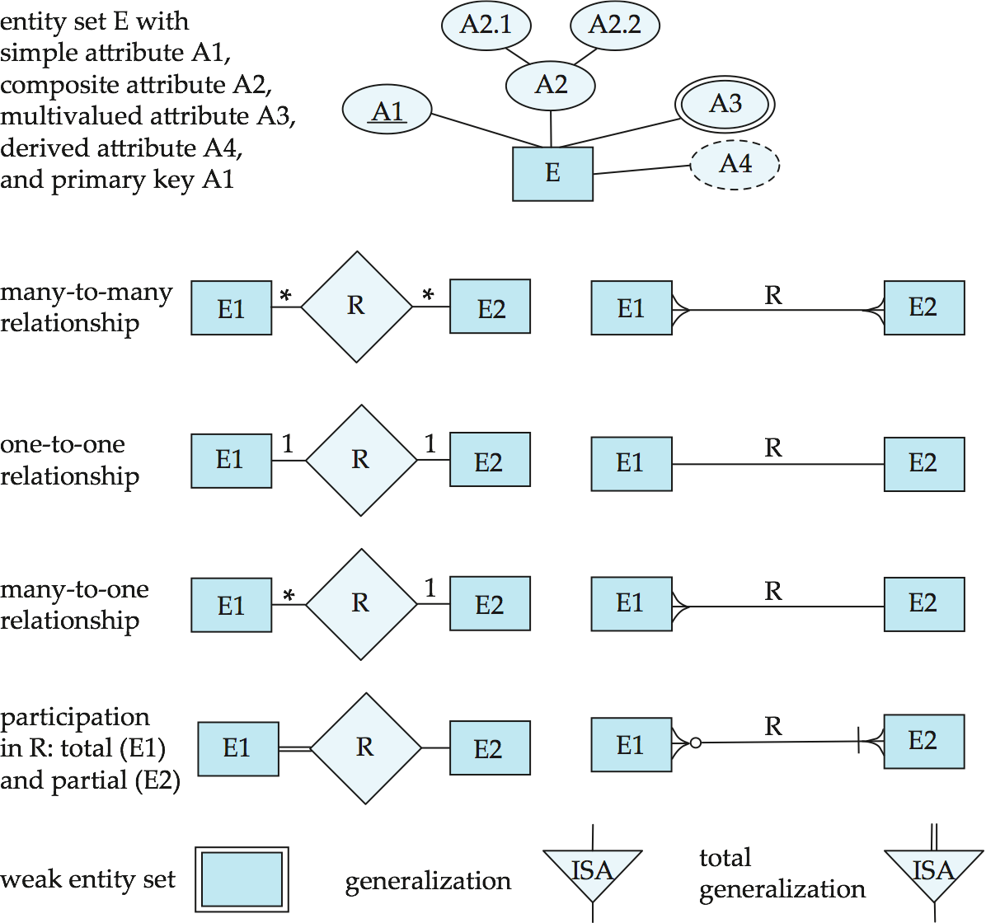
Alternative ER Notations
Chen, IDE1FX, …

Slide 70
Alternative ER Notations
Chen IDE1FX (Crows feet notation)

Slide 71
UML
UML: Unified Modeling Language
UML has many components to graphically model different aspects of an entire software system
UML Class Diagrams correspond to E-R Diagram, but several differences.

Slide 72
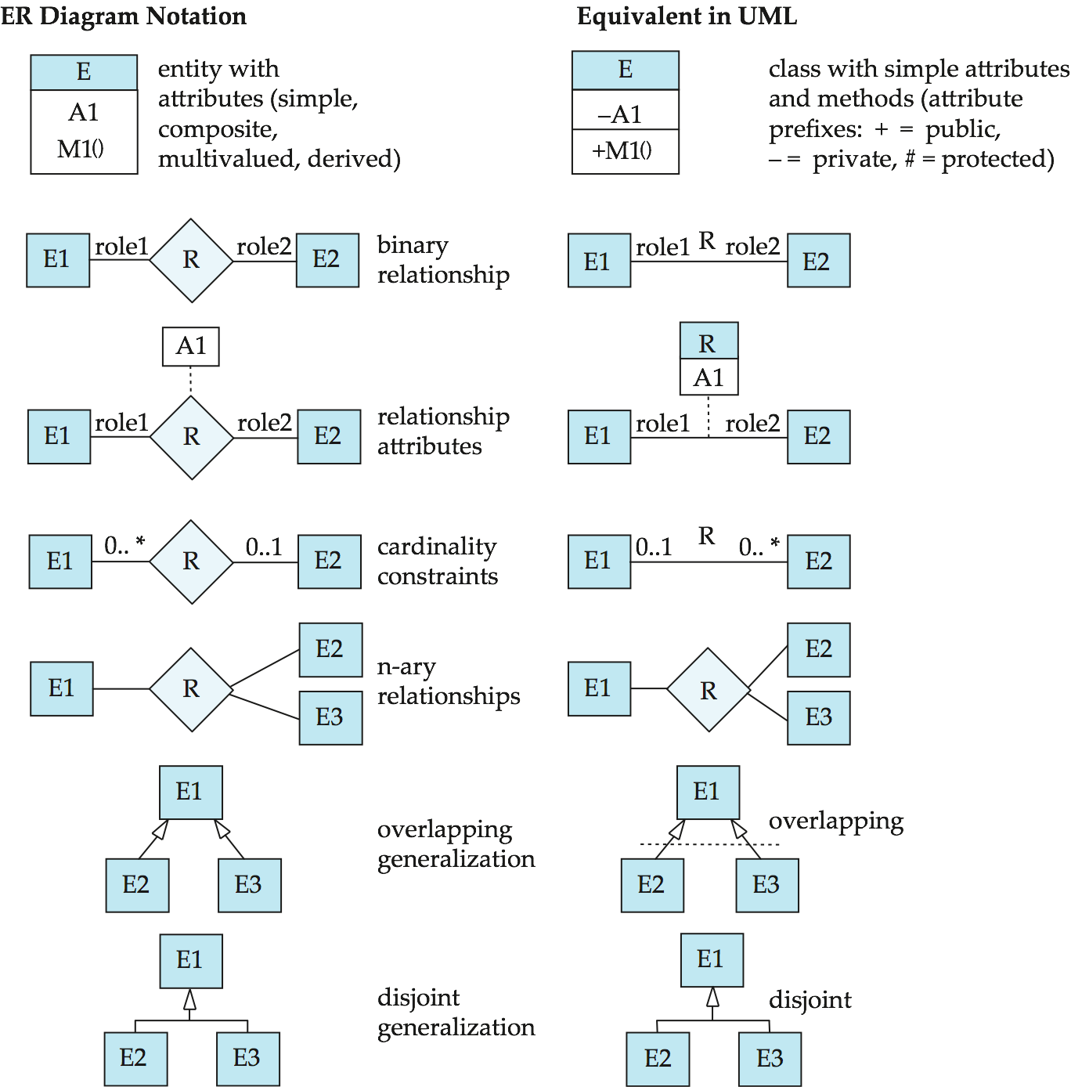
ER vs. UML Class Diagrams
*Note reversal of position in cardinality constraint depiction

Slide 73
ER vs. UML Class Diagrams
ER Diagram Notation
Equivalent in UML
*Generalization can use merged or separate arrows independent of disjoint/overlapping

Slide 74
UML Class Diagrams (Cont.)
Binary relationship sets are represented in UML by just drawing a line connecting the entity sets. The relationship set name is written adjacent to the line.
The role played by an entity set in a relationship set may also be specified by writing the role name on the line, adjacent to the entity set.
The relationship set name may alternatively be written in a box, along with attributes of the relationship set, and the box is connected, using a dotted line, to the line depicting the relationship set.

Slide 75
End of Chapter 7

Slide 76
Chapter 8 Relational Database Design

Slide 77
Chapter 8 Relational Database Design
Features of Good Relational Design
Atomic Domains and First Normal Form
Decomposition Using Functional Dependencies
Functional Dependency Theory
Algorithms for Functional Dependencies
Decomposition Using Multivalued Dependencies
More Normal Form
Database-Design Process
Modeling Temporal Data

Slide 78
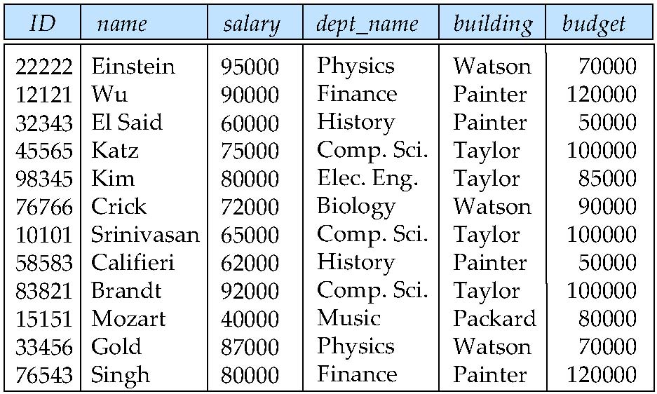
Combine Schemas?
Suppose we combine instructor and department into inst_dept
(No connection to relationship set inst_dept)
Result is possible repetition of information

Slide 79
A Combined Schema Without Repetition
Consider combining relations
sec_class(sec_id, building, room_number) and
section(course_id, sec_id, semester, year)
into one relation
section(course_id, sec_id, semester, year, building, room_number)
No repetition in this case

Slide 80
What About Smaller Schemas?
Suppose we had started with inst_dept. How would we know to split up (decompose) it into instructor and department?
Write a rule “if there were a schema (dept_name, building, budget), then dept_name would be a candidate key”
Denote as a functional dependency:
dept_name → building, budget
In inst_dept, because dept_name is not a candidate key, the building and budget of a department may have to be repeated.
This indicates the need to decompose inst_dept
Not all decompositions are good. Suppose we decompose employee(ID, name, street, city, salary) into
employee1 (ID, name)
employee2 (name, street, city, salary)
The next slide shows how we lose information -- we cannot reconstruct the original employee relation -- and so, this is a lossy decomposition.

Slide 81
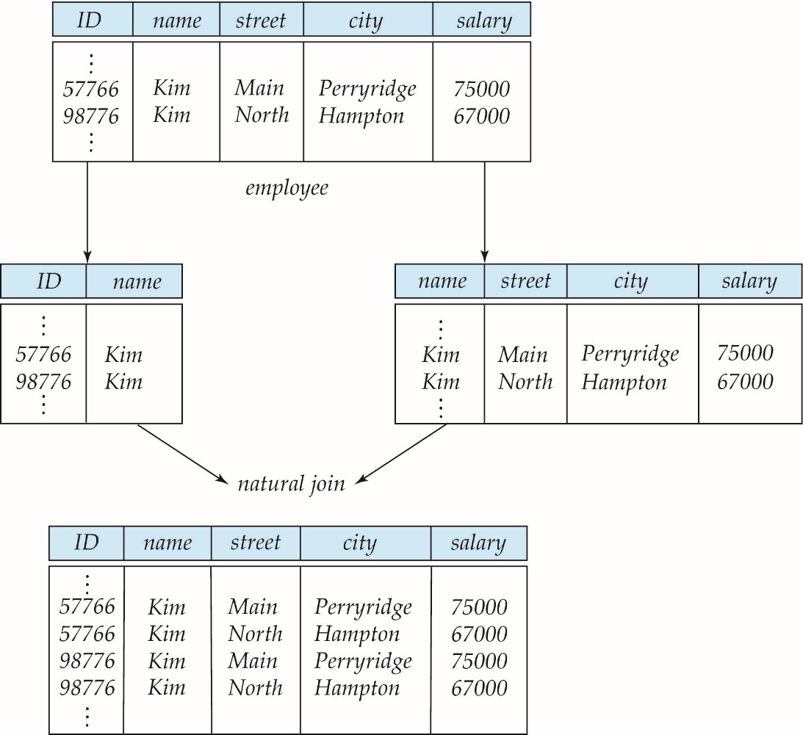
A Lossy Decomposition

Slide 82
Example of Lossless-Join Decomposition
Lossless join decomposition
Decomposition of R = (A, B, C) R₁ = (A, B) R₂ = (B, C)
A
B
C
A
B
B
C
α
β
1
2
A
B
α
β
1
2
1
2
A
B
r
∏_{A,B}(r)
∏_{B,C}(r)
A
B
C
∏_{A} (r) ∏_{B} (r)
α
β
1
2
A
B

Slide 83
First Normal Form
Domain is atomic if its elements are considered to be indivisible units
Examples of non-atomic domains:
Set of names, composite attributes
Identification numbers like CS101 that can be broken up into parts
A relational schema R is in first normal form if the domains of all attributes of R are atomic
Non-atomic values complicate storage and encourage redundant (repeated) storage of data
Example: Set of accounts stored with each customer, and set of owners stored with each account
We assume all relations are in first normal form (and revisit this in Chapter 22: Object Based Databases)

Slide 84
First Normal Form (Cont’d)
Atomicity is actually a property of how the elements of the domain are used.
Example: Strings would normally be considered indivisible
Suppose that students are given roll numbers which are strings of the form CS0012 or EE1127
If the first two characters are extracted to find the department, the domain of roll numbers is not atomic.
Doing so is a bad idea: leads to encoding of information in application program rather than in the database.

Slide 85
Goal — Devise a Theory for the Following
Decide whether a particular relation R is in “good” form.
In the case that a relation R is not in “good” form, decompose it into a set of relations {R₁, R₂, ..., R_{n}} such that
each relation is in good form
the decomposition is a lossless-join decomposition
Our theory is based on:
functional dependencies
multivalued dependencies

Slide 86
Functional Dependencies
Constraints on the set of legal relations.
Require that the value for a certain set of attributes determines uniquely the value for another set of attributes.
A functional dependency is a generalization of the notion of a key.

Slide 87
Functional Dependencies (Cont.)
Let R be a relation schema
α ⊆ R and β ⊆ R
The functional dependency
α → β holds on R if and only if for any legal relations r(R), whenever any two tuples t₁ and t₂ of r agree on the attributes α, they also agree on the attributes β. That is,
t₁[α] = t₂ [α] ⇒ t₁[β ] = t₂ [β ]
Example: Consider r(A,B ) with the following instance of r.
On this instance, A → B does NOT hold, but B → A does hold.
4
1 5
3 7

Slide 88
Functional Dependencies (Cont.)
K is a superkey for relation schema R if and only if K → R
K is a candidate key for R if and only if
K → R, and
for no α ⊂ K, α → R
Functional dependencies allow us to express constraints that cannot be expressed using superkeys. Consider the schema:
inst_dept (ID, name, salary, dept_name, building, budget ).
We expect these functional dependencies to hold:
dept_name→ building
and ID → building
but would not expect the following to hold:
dept_name → salary

Slide 89
Use of Functional Dependencies
We use functional dependencies to:
test relations to see if they are legal under a given set of functional dependencies.
If a relation r is legal under a set F of functional dependencies, we say that r satisfies F.
specify constraints on the set of legal relations
We say that F holds on R if all legal relations on R satisfy the set of functional dependencies F.
Note: A specific instance of a relation schema may satisfy a functional dependency even if the functional dependency does not hold on all legal instances.
For example, a specific instance of instructor may, by chance, satisfy name → ID.

Slide 90
Functional Dependencies (Cont.)
A functional dependency is trivial if it is satisfied by all instances of a relation
Example:
ID, name → ID
name → name
In general, α → β is trivial if β ⊆ α

Slide 91
Closure of a Set of Functional Dependencies
Given a set F of functional dependencies, there are certain other functional dependencies that are logically implied by F.
For example: If A → B and B → C, then we can infer that A → C
The set of all functional dependencies logically implied by F is the closure of F.
We denote the closure of F by F⁺.
F⁺ is a superset of F.

Slide 92
Boyce-Codd Normal Form
A relation schema R is in BCNF with respect to a set F of functional dependencies if for all functional dependencies in F⁺ of the form
α → β
where α ⊆ R and β ⊆ R, at least one of the following holds:
α  → β is trivial (i.e., β ⊆ α)
α is a superkey for R
Example schema not in BCNF:
instr_dept (ID, name, salary, dept_name, building, budget )
because dept_name→ building, budget
holds on instr_dept, but dept_name is not a superkey

Slide 93
Decomposing a Schema into BCNF
Suppose we have a schema R and a non-trivial dependency α →β causes a violation of BCNF.
We decompose R into:
(α U β )
( R - ( β - α ) )
In our example,
α = dept_name
β = building, budget
and inst_dept is replaced by
(α U β ) = ( dept_name, building, budget )
( R - ( β - α ) ) = ( ID, name, salary, dept_name )

Slide 94
BCNF and Dependency Preservation
Constraints, including functional dependencies, are costly to check in practice unless they pertain to only one relation
If it is sufficient to test only those dependencies on each individual relation of a decomposition in order to ensure that all functional dependencies hold, then that decomposition is dependency preserving.
Because it is not always possible to achieve both BCNF and dependency preservation, we consider a weaker normal form, known as third normal form.

Slide 95
Third Normal Form
A relation schema R is in third normal form (3NF) if for all:
α → β in F⁺ at least one of the following holds:
α → β is trivial (i.e., β ∈ α)
α is a superkey for R
Each attribute A in β – α is contained in a candidate key for R.
(NOTE: each attribute may be in a different candidate key)
If a relation is in BCNF it is in 3NF (since in BCNF one of the first two conditions above must hold).
Third condition is a minimal relaxation of BCNF to ensure dependency preservation (will see why later).

Slide 96
Goals of Normalization
Let R be a relation scheme with a set F of functional dependencies.
Decide whether a relation scheme R is in “good” form.
In the case that a relation scheme R is not in “good” form, decompose it into a set of relation scheme {R₁, R₂, ..., R_{n}} such that
each relation scheme is in good form
the decomposition is a lossless-join decomposition
Preferably, the decomposition should be dependency preserving.

Slide 97
How good is BCNF?
There are database schemas in BCNF that do not seem to be sufficiently normalized
Consider a relation
inst_info (ID, child_name, phone)
where an instructor may have more than one phone and can have multiple children
ID
child_name
phone
99999
99999
99999
99999
David
David
William
Willian
512-555-1234
512-555-4321
512-555-1234
512-555-4321
inst_info

Slide 98
How good is BCNF? (Cont.)
There are no non-trivial functional dependencies and therefore the relation is in BCNF
Insertion anomalies – i.e., if we add a phone 981-992-3443 to 99999, we need to add two tuples
(99999, David, 981-992-3443) (99999, William, 981-992-3443)

Slide 99
How good is BCNF? (Cont.)
Therefore, it is better to decompose inst_info into:
ID
child_name
inst_child
99999
99999
99999
99999
David
David
William
Willian
ID
phone
inst_phone
99999
99999
99999
99999
512-555-1234
512-555-4321
512-555-1234
512-555-4321
This suggests the need for higher normal forms, such as Fourth Normal Form (4NF), which we shall see later.

Slide 100
Functional-Dependency Theory
We now consider the formal theory that tells us which functional dependencies are implied logically by a given set of functional dependencies.
We then develop algorithms to generate lossless decompositions into BCNF and 3NF
We then develop algorithms to test if a decomposition is dependency-preserving

Slide 101
Closure of a Set of Functional Dependencies
Given a set F set of functional dependencies, there are certain other functional dependencies that are logically implied by F.
For e.g.: If A → B and B → C, then we can infer that A → C
The set of all functional dependencies logically implied by F is the closure of F.
We denote the closure of F by F⁺.

Slide 102
Closure of a Set of Functional Dependencies
We can find F^{+,} the closure of F, by repeatedly applying Armstrong’s Axioms:
if β ⊆ α, then α → β (reflexivity)
if α → β, then γ α → γ β (augmentation)
if α → β, and β → γ, then α → γ (transitivity)
These rules are
sound (generate only functional dependencies that actually hold), and
complete (generate all functional dependencies that hold).

Slide 103
Example
R = (A, B, C, G, H, I) F = { A → B A → C CG → H CG → I B → H}
some members of F⁺
A → H
by transitivity from A → B and B → H
AG → I
by augmenting A → C with G, to get AG → CG and then transitivity with CG → I
CG → HI
by augmenting CG → I to infer CG → CGI,
and augmenting of CG → H to infer CGI → HI,
and then transitivity

Slide 104
Procedure for Computing F⁺
To compute the closure of a set of functional dependencies F:
F ⁺ = F repeat for each functional dependency f in F⁺ apply reflexivity and augmentation rules on f add the resulting functional dependencies to F ⁺ for each pair of functional dependencies f₁and f₂ in F ⁺ if f₁ and f₂ can be combined using transitivity then add the resulting functional dependency to F ⁺ until F ⁺ does not change any further
NOTE: We shall see an alternative procedure for this task later

Slide 105
Closure of Functional Dependencies (Cont.)
Additional rules:
If α → β holds and α → γ holds, then α → β γ holds (union)
If α → β γ holds, then α → β holds and α → γ holds (decomposition)
If α → β holds and γ β → δ holds, then α γ → δ holds (pseudotransitivity)
The above rules can be inferred from Armstrong’s axioms.

Slide 106
Closure of Attribute Sets
Given a set of attributes α, define the closure of α under F (denoted by α⁺) as the set of attributes that are functionally determined by α under F
Algorithm to compute α⁺, the closure of α under F
result := α; while (changes to result) do for each β → γ in F do begin if β ⊆ result then result := result ∪ γ end

Slide 107
Example of Attribute Set Closure
R = (A, B, C, G, H, I)
F = {A → B A → C CG → H CG → I B → H}
(AG)⁺
1. result = AG
2. result = ABCG (A → C and A → B)
3. result = ABCGH (CG → H and CG ⊆ AGBC)
4. result = ABCGHI (CG → I and CG ⊆ AGBCH)
Is AG a candidate key?
Is AG a super key?
Does AG → R? == Is (AG)⁺ ⊇ R
Is any subset of AG a superkey?
Does A → R? == Is (A)⁺ ⊇ R
Does G → R? == Is (G)⁺ ⊇ R

Slide 108
Uses of Attribute Closure
There are several uses of the attribute closure algorithm:
Testing for superkey:
To test if α is a superkey, we compute α^{+,} and check if α⁺ contains all attributes of R.
Testing functional dependencies
To check if a functional dependency α → β holds (or, in other words, is in F⁺), just check if β ⊆ α⁺.
That is, we compute α⁺ by using attribute closure, and then check if it contains β.
Is a simple and cheap test, and very useful
Computing closure of F
For each γ ⊆ R, we find the closure γ⁺, and for each S ⊆ γ⁺, we output a functional dependency γ → S.

Slide 109
Canonical Cover
Sets of functional dependencies may have redundant dependencies that can be inferred from the others
For example: A → C is redundant in: {A → B, B → C, A→ C}
Parts of a functional dependency may be redundant
E.g.: on RHS: {A → B, B → C, A → CD} can be simplified to {A → B, B → C, A → D}
E.g.: on LHS: {A → B, B → C, AC → D} can be simplified to {A → B, B → C, A → D}
Intuitively, a canonical cover of F is a “minimal” set of functional dependencies equivalent to F, having no redundant dependencies or redundant parts of dependencies

Slide 110
Extraneous Attributes
Consider a set F of functional dependencies and the functional dependency α → β in F.
Attribute A is extraneous in α if A ∈ α and F logically implies (F – {α → β}) ∪ {(α – A) → β}.
Attribute A is extraneous in β if A ∈ β and the set of functional dependencies (F – {α → β}) ∪ {α →(β – A)} logically implies F.
Note: implication in the opposite direction is trivial in each of the cases above, since a “stronger” functional dependency always implies a weaker one
Example: Given F = {A → C, AB → C }
B is extraneous in AB → C because {A → C, AB → C} logically implies A → C (I.e. the result of dropping B from AB → C).
Example: Given F = {A → C, AB → CD}
C is extraneous in AB → CD since AB → C can be inferred even after deleting C

Slide 111
Testing if an Attribute is Extraneous
Consider a set F of functional dependencies and the functional dependency α → β in F.
To test if attribute A ∈ α is extraneous in α
compute ({α} – A)⁺ using the dependencies in F
check that ({α} – A)⁺ contains β; if it does, A is extraneous in α
To test if attribute A ∈ β is extraneous in β
compute α⁺ using only the dependencies in F’ = (F – {α → β}) ∪ {α →(β – A)},
check that α⁺ contains A; if it does, A is extraneous in β

Slide 112
Canonical Cover
A canonical cover for F is a set of dependencies F_{c} such that
F logically implies all dependencies in F_{c,} and
F_{c} logically implies all dependencies in F, and
No functional dependency in F_{c} contains an extraneous attribute, and
Each left side of functional dependency in F_{c} is unique.
To compute a canonical cover for F: repeat Use the union rule to replace any dependencies in F α₁ → β₁ and α₁ → β₂ with α₁ → β₁ β₂ Find a functional dependency α → β with an extraneous attribute either in α or in β /* Note: test for extraneous attributes done using F_{c,} not F*/ If an extraneous attribute is found, delete it from α → β until F does not change
Note: Union rule may become applicable after some extraneous attributes have been deleted, so it has to be re-applied

Slide 113
Computing a Canonical Cover
R = (A, B, C) F = {A → BC B → C A → B AB → C}
Combine A → BC and A → B into A → BC
Set is now {A → BC, B → C, AB → C}
A is extraneous in AB → C
Check if the result of deleting A from AB → C is implied by the other dependencies
Yes: in fact, B → C is already present!
Set is now {A → BC, B → C}
C is extraneous in A → BC
Check if A → C is logically implied by A → B and the other dependencies
Yes: using transitivity on A → B and B → C.
Can use attribute closure of A in more complex cases
The canonical cover is: A → B B → C

Slide 114
Lossless-join Decomposition
For the case of R = (R₁, R₂), we require that for all possible relations r on schema R
r = ∏_{R1} (r ) ∏_{R2} (r )
A decomposition of R into R₁ and R₂ is lossless join if at least one of the following dependencies is in F⁺:
R₁ ∩ R₂ → R₁
R₁ ∩ R₂ → R₂
The above functional dependencies are a sufficient condition for lossless join decomposition; the dependencies are a necessary condition only if all constraints are functional dependencies

Slide 115
Example
R = (A, B, C) F = {A → B, B → C)
Can be decomposed in two different ways
R₁ = (A, B), R₂ = (B, C)
Lossless-join decomposition:
R₁ ∩ R₂ = {B} and B → BC
Dependency preserving
R₁ = (A, B), R₂ = (A, C)
Lossless-join decomposition:
R₁ ∩ R₂ = {A} and A → AB
Not dependency preserving (cannot check B → C without computing R₁ R₂)

Slide 116
Dependency Preservation
Let F_{i} be the set of dependencies F ⁺ that include only attributes in R_{i}.
A decomposition is dependency preserving, if
(F₁ ∪ F₂ ∪ … ∪ F_{n} )⁺ = F ⁺
If it is not, then checking updates for violation of functional dependencies may require computing joins, which is expensive.

Slide 117
Testing for Dependency Preservation
To check if a dependency α → β is preserved in a decomposition of R into R₁, R₂, …, R_{n} we apply the following test (with attribute closure done with respect to F)
result = α while (changes to result) do for each R_{i} in the decomposition t = (result ∩ R_{i})⁺ ∩ R_{i} result = result ∪ t
If result contains all attributes in β, then the functional dependency α → β is preserved.
We apply the test on all dependencies in F to check if a decomposition is dependency preserving
This procedure takes polynomial time, instead of the exponential time required to compute F⁺ and (F₁ ∪ F₂ ∪ … ∪ F_{n})⁺

Slide 118
Example
R = (A, B, C ) F = {A → B B → C} Key = {A}
R is not in BCNF
Decomposition R₁ = (A, B), R₂ = (B, C)
R₁ and R₂ in BCNF
Lossless-join decomposition
Dependency preserving

Slide 119
Testing for BCNF
To check if a non-trivial dependency α →β causes a violation of BCNF
1. compute α⁺ (the attribute closure of α), and
2. verify that it includes all attributes of R, that is, it is a superkey of R.
Simplified test: To check if a relation schema R is in BCNF, it suffices to check only the dependencies in the given set F for violation of BCNF, rather than checking all dependencies in F⁺.
If none of the dependencies in F causes a violation of BCNF, then none of the dependencies in F⁺ will cause a violation of BCNF either.
However, simplified test using only F is incorrect when testing a relation in a decomposition of R
Consider R = (A, B, C, D, E), with F = { A → B, BC → D}
Decompose R into R₁ = (A,B) and R₂ = (A,C,D, E)
Neither of the dependencies in F contain only attributes from (A,C,D,E) so we might be mislead into thinking R₂ satisfies BCNF.
In fact, dependency AC → D in F⁺ shows R₂ is not in BCNF.

Slide 120
Testing Decomposition for BCNF
To check if a relation R_{i} in a decomposition of R is in BCNF,
Either test R_{i} for BCNF with respect to the restriction of F to R_{i} (that is, all FDs in F⁺ that contain only attributes from R_{i})
or use the original set of dependencies F that hold on R, but with the following test:
for every set of attributes α ⊆ R_{i}, check that α⁺ (the attribute closure of α) either includes no attribute of R_{i}- α, or includes all attributes of R_{i}.
If the condition is violated by some α → β in F, the dependency α → (α⁺ - α ) ∩ R_{i} can be shown to hold on R_{i}, and R_{i} violates BCNF.
We use above dependency to decompose R_{i}

Slide 121
BCNF Decomposition Algorithm
result := {R }; done := false; compute F ⁺; while (not done) do if (there is a schema R_{i} in result that is not in BCNF) then begin let α  → β be a nontrivial functional dependency that holds on R_{i} such that α  → R_{i} is not in F ⁺, and α ∩ β = ∅; result := (result – R_{i} ) ∪ (R_{i} – β) ∪ (α, β ); end else done := true;
Note: each R_{i} is in BCNF, and decomposition is lossless-join.

Slide 122
Example of BCNF Decomposition
R = (A, B, C ) F = {A → B B → C} Key = {A}
R is not in BCNF (B → C but B is not superkey)
Decomposition
R₁ = (B, C)
R₂ = (A,B)

Slide 123
Example of BCNF Decomposition
class (course_id, title, dept_name, credits, sec_id, semester, year, building, room_number, capacity, time_slot_id)
Functional dependencies:
course_id→ title, dept_name, credits
building, room_number→capacity
course_id, sec_id, semester, year→building, room_number, time_slot_id
A candidate key {course_id, sec_id, semester, year}.
BCNF Decomposition:
course_id→ title, dept_name, credits holds
but course_id is not a superkey.
We replace class by:
course(course_id, title, dept_name, credits)
class-1 (course_id, sec_id, semester, year, building, room_number, capacity, time_slot_id)

Slide 124
BCNF Decomposition (Cont.)
course is in BCNF
How do we know this?
building, room_number→capacity holds on class-1
but {building, room_number} is not a superkey for class-1.
We replace class-1 by:
classroom (building, room_number, capacity)
section (course_id, sec_id, semester, year, building, room_number, time_slot_id)
classroom and section are in BCNF.

Slide 125
BCNF and Dependency Preservation
It is not always possible to get a BCNF decomposition that is dependency preserving
R = (J, K, L ) F = {JK → L L → K } Two candidate keys = JK and JL
R is not in BCNF
Any decomposition of R will fail to preserve
JK → L
This implies that testing for JK → L requires a join

Slide 126
Third Normal Form: Motivation
There are some situations where
BCNF is not dependency preserving, and
efficient checking for FD violation on updates is important
Solution: define a weaker normal form, called Third Normal Form (3NF)
Allows some redundancy (with resultant problems; we will see examples later)
But functional dependencies can be checked on individual relations without computing a join.
There is always a lossless-join, dependency-preserving decomposition into 3NF.

Slide 127
3NF Example
Relation dept_advisor:
dept_advisor (s_ID, i_ID, dept_name) F = {s_ID, dept_name → i_ID, i_ID → dept_name}
Two candidate keys: s_ID, dept_name, and i_ID, s_ID
R is in 3NF
s_ID, dept_name → i_ID s_ID
dept_name is a superkey
i_ID → dept_name
dept_name is contained in a candidate key

Slide 128
Redundancy in 3NF
There is some redundancy in this schema
Example of problems due to redundancy in 3NF
R = (J, K, L) F = {JK → L, L → K }
J
L
K
j₁
j₂
j₃
null
l₁
l₁
l₁
l₂
k₁
k₁
k₁
k₂
repetition of information (e.g., the relationship l₁, k₁)
(i_ID, dept_name)
need to use null values (e.g., to represent the relationship l₂, k₂ where there is no corresponding value for J).
(i_ID, dept_nameI) if there is no separate relation mapping instructors to departments

Slide 129
Testing for 3NF
Optimization: Need to check only FDs in F, need not check all FDs in F⁺.
Use attribute closure to check for each dependency α → β, if α is a superkey.
If α is not a superkey, we have to verify if each attribute in β is contained in a candidate key of R
this test is rather more expensive, since it involve finding candidate keys
testing for 3NF has been shown to be NP-hard
Interestingly, decomposition into third normal form (described shortly) can be done in polynomial time

Slide 130
3NF Decomposition Algorithm
Let F_{c} be a canonical cover for F; i := 0; for each functional dependency α → β in F_{c} do if none of the schemas R_{j}, 1 ≤ j ≤ i contains α β then begin i := i + 1; R_{i} := α β end if none of the schemas R_{j}, 1 ≤ j ≤ i contains a candidate key for R then begin i := i + 1; R_{i} := any candidate key for R; end /* Optionally, remove redundant relations */
repeat if any schema R_{j} is contained in another schema R_{k} then /* delete R_{j} */ R_{j} = R;; i=i-1; return (R₁, R₂, ..., R_{i})

Slide 131
3NF Decomposition Algorithm (Cont.)
Above algorithm ensures:
each relation schema R_{i} is in 3NF
decomposition is dependency preserving and lossless-join
Proof of correctness is at end of this presentation (click here)

Slide 132
3NF Decomposition: An Example
Relation schema:
cust_banker_branch = (customer_id, employee_id, branch_name, type )
The functional dependencies for this relation schema are:
customer_id, employee_id → branch_name, type
employee_id → branch_name
customer_id, branch_name → employee_id
We first compute a canonical cover
branch_name is extraneous in the r.h.s. of the 1st dependency
No other attribute is extraneous, so we get F_{C} =
customer_id, employee_id → type employee_id → branch_name customer_id, branch_name → employee_id

Slide 133
3NF Decompsition Example (Cont.)
The for loop generates following 3NF schema:
(customer_id, employee_id, type )
(employee_id, branch_name)
(customer_id, branch_name, employee_id)
Observe that (customer_id, employee_id, type ) contains a candidate key of the original schema, so no further relation schema needs be added
At end of for loop, detect and delete schemas, such as (employee_id, branch_name), which are subsets of other schemas
result will not depend on the order in which FDs are considered
The resultant simplified 3NF schema is:
(customer_id, employee_id, type)
(customer_id, branch_name, employee_id)

Slide 134
Comparison of BCNF and 3NF
It is always possible to decompose a relation into a set of relations that are in 3NF such that:
the decomposition is lossless
the dependencies are preserved
It is always possible to decompose a relation into a set of relations that are in BCNF such that:
the decomposition is lossless
it may not be possible to preserve dependencies.

Slide 135
Design Goals
Goal for a relational database design is:
BCNF.
Lossless join.
Dependency preservation.
If we cannot achieve this, we accept one of
Lack of dependency preservation
Redundancy due to use of 3NF
Interestingly, SQL does not provide a direct way of specifying functional dependencies other than superkeys.
Can specify FDs using assertions, but they are expensive to test, (and currently not supported by any of the widely used databases!)
Even if we had a dependency preserving decomposition, using SQL we would not be able to efficiently test a functional dependency whose left hand side is not a key.

Slide 136
Multivalued Dependencies
Suppose we record names of children, and phone numbers for instructors:
inst_child(ID, child_name)
inst_phone(ID, phone_number)
If we were to combine these schemas to get
inst_info(ID, child_name, phone_number)
Example data: (99999, David, 512-555-1234) (99999, David, 512-555-4321) (99999, William, 512-555-1234) (99999, William, 512-555-4321)
This relation is in BCNF
Why?

Slide 137
Multivalued Dependencies (MVDs)
Let R be a relation schema and let α ⊆ R and β ⊆ R. The multivalued dependency
α →→ β
holds on R if in any legal relation r(R), for all pairs for tuples t₁ and t₂ in r such that t₁[α] = t₂ [α], there exist tuples t₃ and t₄ in r such that:
t₁[α] = t₂ [α] = t₃ [α] = t₄ [α] t₃[β] = t₁ [β] t₃[R – β] = t₂[R – β] t₄ [β] = t₂[β] t₄[R – β] = t₁[R – β]

Slide 138
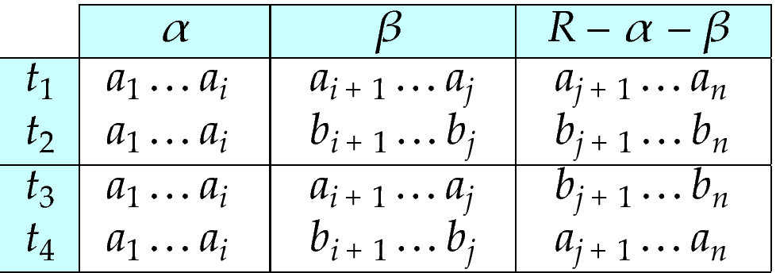
MVD (Cont.)
Tabular representation of α →→ β

Slide 139
Example
Let R be a relation schema with a set of attributes that are partitioned into 3 nonempty subsets.
Y, Z, W
We say that Y →→ Z (Y multidetermines Z ) if and only if for all possible relations r (R )
< y₁, z₁, w₁ > ∈ r and < y₁, z₂, w₂ > ∈ r
then
< y₁, z₁, w₂ > ∈ r and < y₁, z₂, w₁ > ∈ r
Note that since the behavior of Z and W are identical it follows that
Y →→ Z if Y →→ W

Slide 140
Example (Cont.)
In our example:
ID →→ child_name ID →→ phone_number
The above formal definition is supposed to formalize the notion that given a particular value of Y (ID) it has associated with it a set of values of Z (child_name) and a set of values of W (phone_number), and these two sets are in some sense independent of each other.
Note:
If Y → Z then Y →→ Z
Indeed we have (in above notation) Z₁ = Z₂ The claim follows.

Slide 141
Use of Multivalued Dependencies
We use multivalued dependencies in two ways:
1. To test relations to determine whether they are legal under a given set of functional and multivalued dependencies
2. To specify constraints on the set of legal relations. We shall thus concern ourselves only with relations that satisfy a given set of functional and multivalued dependencies.
If a relation r fails to satisfy a given multivalued dependency, we can construct a relations r′ that does satisfy the multivalued dependency by adding tuples to r.

Slide 142
Theory of MVDs
From the definition of multivalued dependency, we can derive the following rule:
If α → β, then α →→ β
That is, every functional dependency is also a multivalued dependency
The closure D⁺ of D is the set of all functional and multivalued dependencies logically implied by D.
We can compute D⁺ from D, using the formal definitions of functional dependencies and multivalued dependencies.
We can manage with such reasoning for very simple multivalued dependencies, which seem to be most common in practice
For complex dependencies, it is better to reason about sets of dependencies using a system of inference rules (see Appendix C).

Slide 143
Fourth Normal Form
A relation schema R is in 4NF with respect to a set D of functional and multivalued dependencies if for all multivalued dependencies in D⁺ of the form α →→ β, where α ⊆ R and β ⊆ R, at least one of the following hold:
α →→ β is trivial (i.e., β ⊆ α or α ∪ β = R)
α is a superkey for schema R
If a relation is in 4NF it is in BCNF

Slide 144
Restriction of Multivalued Dependencies
The restriction of D to R_{i} is the set D_{i} consisting of
All functional dependencies in D⁺ that include only attributes of R_{i}
All multivalued dependencies of the form
α →→ (β ∩ R_{i})
where α ⊆ R_{i} and α →→ β is in D⁺

Slide 145
4NF Decomposition Algorithm
result: = {R}; done := false; compute D⁺; Let D_{i} denote the restriction of D⁺ to R_{i}
while (not done) if (there is a schema R_{i} in result that is not in 4NF) then begin
let α →→ β be a nontrivial multivalued dependency that holds on R_{i} such that α → R_{i} is not in D_{i}, and α∩β=φ; result := (result - R_{i}) ∪ (R_{i} - β) ∪ (α, β); end else done:= true;
Note: each R_{i} is in 4NF, and decomposition is lossless-join

Slide 146
Example
R =(A, B, C, G, H, I)
F ={ A →→ B
B →→ HI
CG →→ H }
R is not in 4NF since A →→ B and A is not a superkey for R
Decomposition
a) R₁ = (A, B) (R₁ is in 4NF)
b) R₂ = (A, C, G, H, I) (R₂ is not in 4NF, decompose into R₃ and R₄)
c) R₃ = (C, G, H) (R₃ is in 4NF)
d) R₄ = (A, C, G, I) (R₄ is not in 4NF, decompose into R₅ and R₆)
A →→ B and B →→ HI ➔ A →→ HI, (MVD transitivity), and
and hence A →→ I (MVD restriction to R₄)
e) R₅ = (A, I) (R₅ is in 4NF)
f)R₆ = (A, C, G) (R₆ is in 4NF)

Slide 147
Further Normal Forms
Join dependencies generalize multivalued dependencies
lead to project-join normal form (PJNF) (also called fifth normal form)
A class of even more general constraints, leads to a normal form called domain-key normal form.
Problem with these generalized constraints: are hard to reason with, and no set of sound and complete set of inference rules exists.
Hence rarely used

Slide 148
Overall Database Design Process
We have assumed schema R is given
R could have been generated when converting E-R diagram to a set of tables.
R could have been a single relation containing all attributes that are of interest (called universal relation).
Normalization breaks R into smaller relations.
R could have been the result of some ad hoc design of relations, which we then test/convert to normal form.

Slide 149
ER Model and Normalization
When an E-R diagram is carefully designed, identifying all entities correctly, the tables generated from the E-R diagram should not need further normalization.
However, in a real (imperfect) design, there can be functional dependencies from non-key attributes of an entity to other attributes of the entity
Example: an employee entity with attributes department_name and building, and a functional dependency department_name→ building
Good design would have made department an entity
Functional dependencies from non-key attributes of a relationship set possible, but rare --- most relationships are binary

Slide 150
Denormalization for Performance
May want to use non-normalized schema for performance
For example, displaying prereqs along with course_id, and title requires join of course with prereq
Alternative 1: Use denormalized relation containing attributes of course as well as prereq with all above attributes
faster lookup
extra space and extra execution time for updates
extra coding work for programmer and possibility of error in extra code
Alternative 2: use a materialized view defined as course prereq
Benefits and drawbacks same as above, except no extra coding work for programmer and avoids possible errors

Slide 151
Other Design Issues
Some aspects of database design are not caught by normalization
Examples of bad database design, to be avoided:
Instead of earnings (company_id, year, amount ), use
earnings_2004, earnings_2005, earnings_2006, etc., all on the schema (company_id, earnings).
Above are in BCNF, but make querying across years difficult and needs new table each year
company_year (company_id, earnings_2004, earnings_2005, earnings_2006)
Also in BCNF, but also makes querying across years difficult and requires new attribute each year.
Is an example of a crosstab, where values for one attribute become column names
Used in spreadsheets, and in data analysis tools

Slide 152
Modeling Temporal Data
Temporal data have an association time interval during which the data are valid.
A snapshot is the value of the data at a particular point in time
Several proposals to extend ER model by adding valid time to
attributes, e.g., address of an instructor at different points in time
entities, e.g., time duration when a student entity exists
relationships, e.g., time during which an instructor was associated with a student as an advisor.
But no accepted standard
Adding a temporal component results in functional dependencies like
ID → street, city
not to hold, because the address varies over time
A temporal functional dependency X → Y holds on schema R if the functional dependency X → Y holds on all snapshots for all legal instances r (R).
t

Slide 153
Modeling Temporal Data (Cont.)
In practice, database designers may add start and end time attributes to relations
E.g., course(course_id, course_title) is replaced by
course(course_id, course_title, start, end)
Constraint: no two tuples can have overlapping valid times
Hard to enforce efficiently
Foreign key references may be to current version of data, or to data at a point in time
E.g., student transcript should refer to course information at the time the course was taken

Slide 154
End of Chapter

Slide 155
Proof of Correctness of 3NF Decomposition Algorithm

Slide 156
Correctness of 3NF Decomposition Algorithm
3NF decomposition algorithm is dependency preserving (since there is a relation for every FD in F_{c})
Decomposition is lossless
A candidate key (C ) is in one of the relations R_{i} in decomposition
Closure of candidate key under F_{c} must contain all attributes in R.
Follow the steps of attribute closure algorithm to show there is only one tuple in the join result for each tuple in R_{i}

Slide 157
Correctness of 3NF Decomposition Algorithm (Cont’d.)
Claim: if a relation R_{i} is in the decomposition generated by the
above algorithm, then R_{i} satisfies 3NF.
Let R_{i} be generated from the dependency α → β
Let γ → B be any non-trivial functional dependency on R_{i}. (We need only consider FDs whose right-hand side is a single attribute.)
Now, B can be in either β or α but not in both. Consider each case separately.

Slide 158
Correctness of 3NF Decomposition (Cont’d.)
Case 1: If B in β:
If γ is a superkey, the 2nd condition of 3NF is satisfied
Otherwise α must contain some attribute not in γ
Since γ → B is in F⁺ it must be derivable from F_{c}, by using attribute closure on γ.
Attribute closure not have used α →β. If it had been used, α must be contained in the attribute closure of γ, which is not possible, since we assumed γ is not a superkey.
Now, using α→ (β- {B}) and γ → B, we can derive α →B
(since γ ⊆ α β, and B ∉ γ since γ → B is non-trivial)
Then, B is extraneous in the right-hand side of α →β; which is not possible since α →β is in F_{c}.
Thus, if B is in β then γ must be a superkey, and the second condition of 3NF must be satisfied.

Slide 159
Correctness of 3NF Decomposition (Cont’d.)
Case 2: B is in α.
Since α is a candidate key, the third alternative in the definition of 3NF is trivially satisfied.
In fact, we cannot show that γ is a superkey.
This shows exactly why the third alternative is present in the definition of 3NF.
Q.E.D.

Slide 160
Figure 8.02

Slide 161
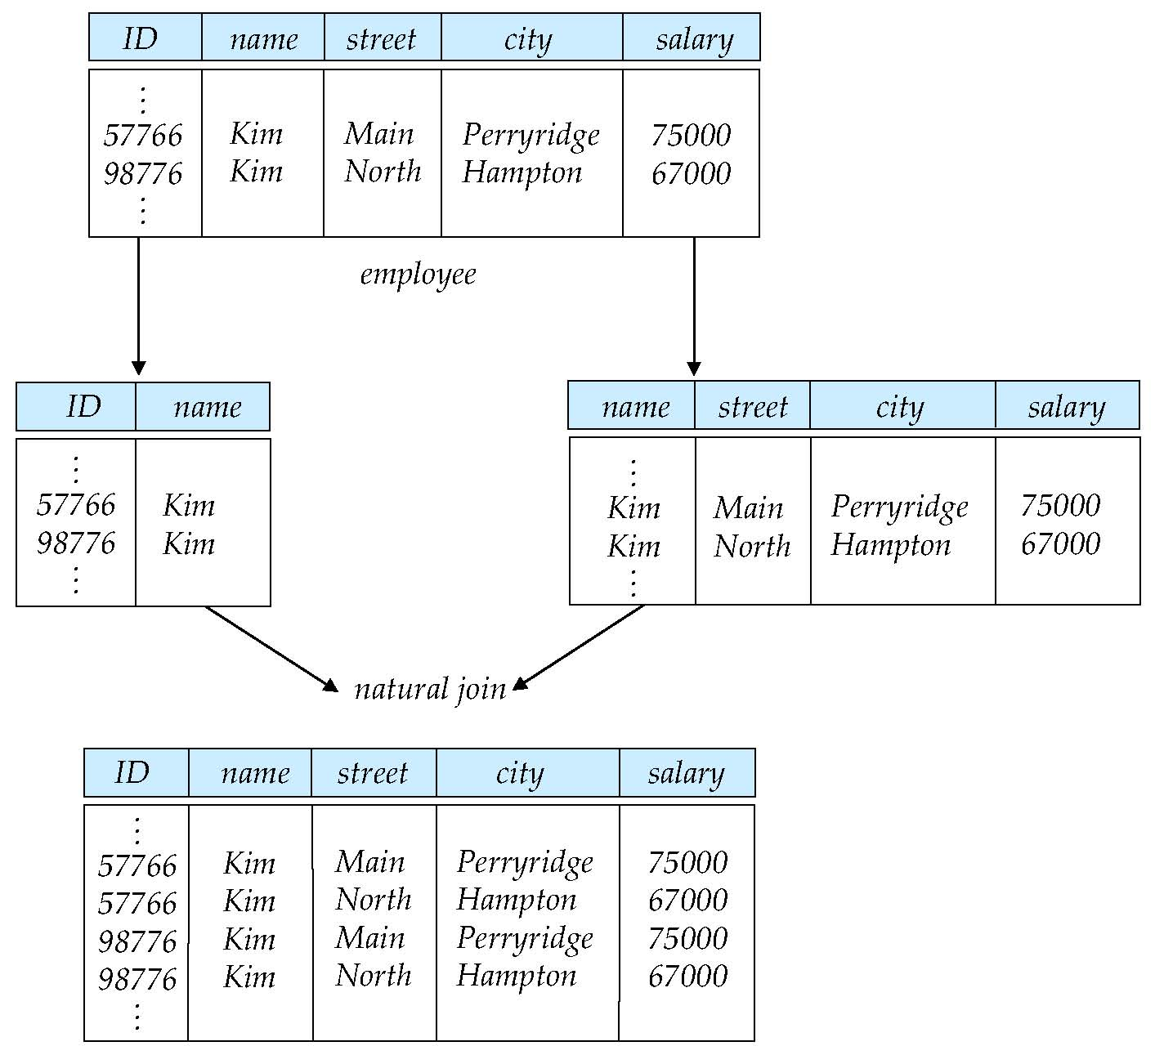
Figure 8.03

Slide 162
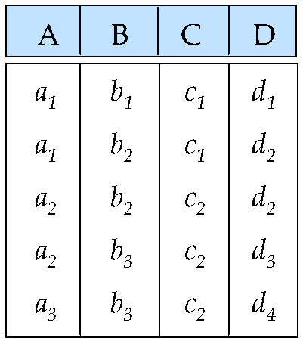
Figure 8.04

Slide 163
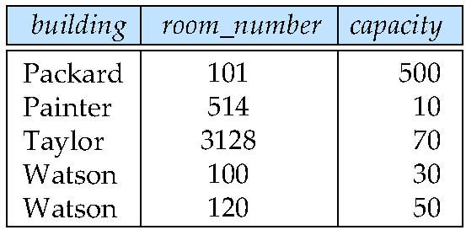
Figure 8.05

Slide 164
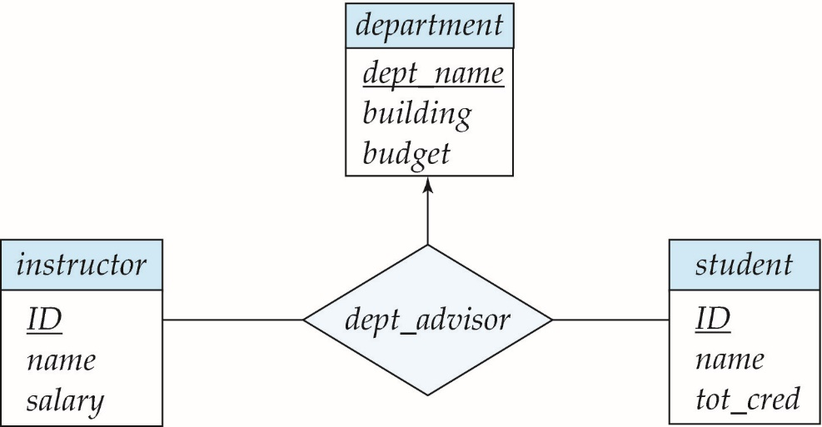
Figure 8.06

Slide 165
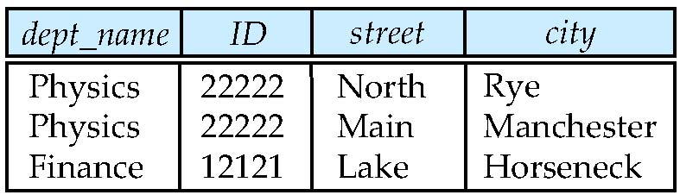
Figure 8.14

Slide 166
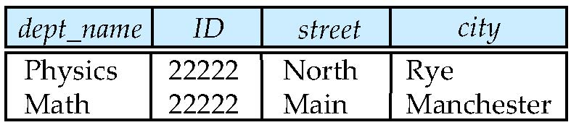
Figure 8.15

Slide 167
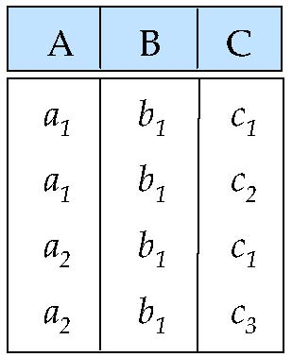
Figure 8.17

